Slide 1

Software Project III Presentation
Project Title: CarHub [Online Car Selling and Equipment Platform]
Presented By
1. MD:ALRAZI TALUKDER ID:221-15-5356
2. MD.BILAYET HOSSAIN ID:221-15-5821

Slide 2
Outline
Objective
Design Phase
Development Phase
Future Work
Conclusion
Software Project III Presentation

Slide 3
Objective
01
About the Project
Customer can buy cars and its equipment from this website and authority can manage the Shop in online
02
Major Requirements
Html CSS and Javascript for frontend development
03
Project Goals
Make the consumer hassle-free in buying Products and a proper management system
Software Project III Presentation

Slide 4




Design Phase
Frontend
Database
Backend
Spring Security: JWT-based authentication and authorization
RESTful APIs: for handling bus ticket reservations, cancellations
Role-based access control (RBAC): for managing user roles and permissions
Html
CSS
javaScript
Software Project III Presentation

Slide 5
Development Phase
Features
Authentication & Authorization
Secure Payment System
Authentication &Aut
Admin Management
Reporting and Analytics
Software Project III Presentation

Slide 6
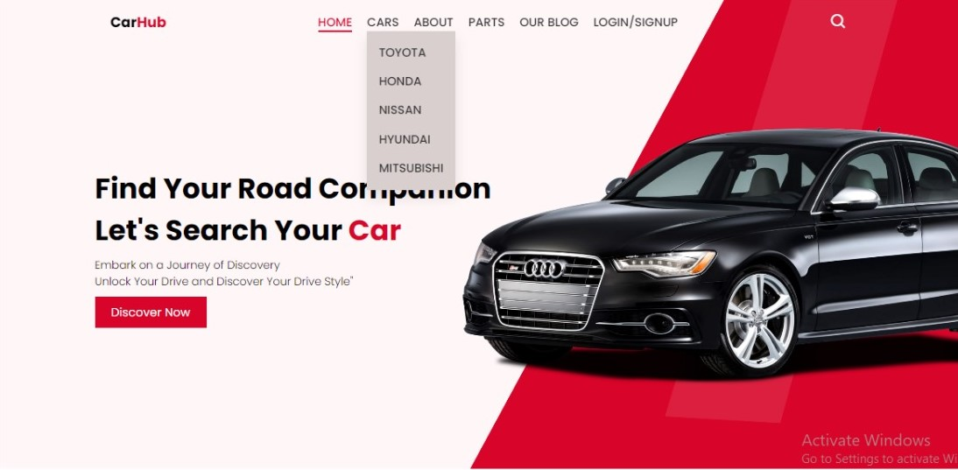
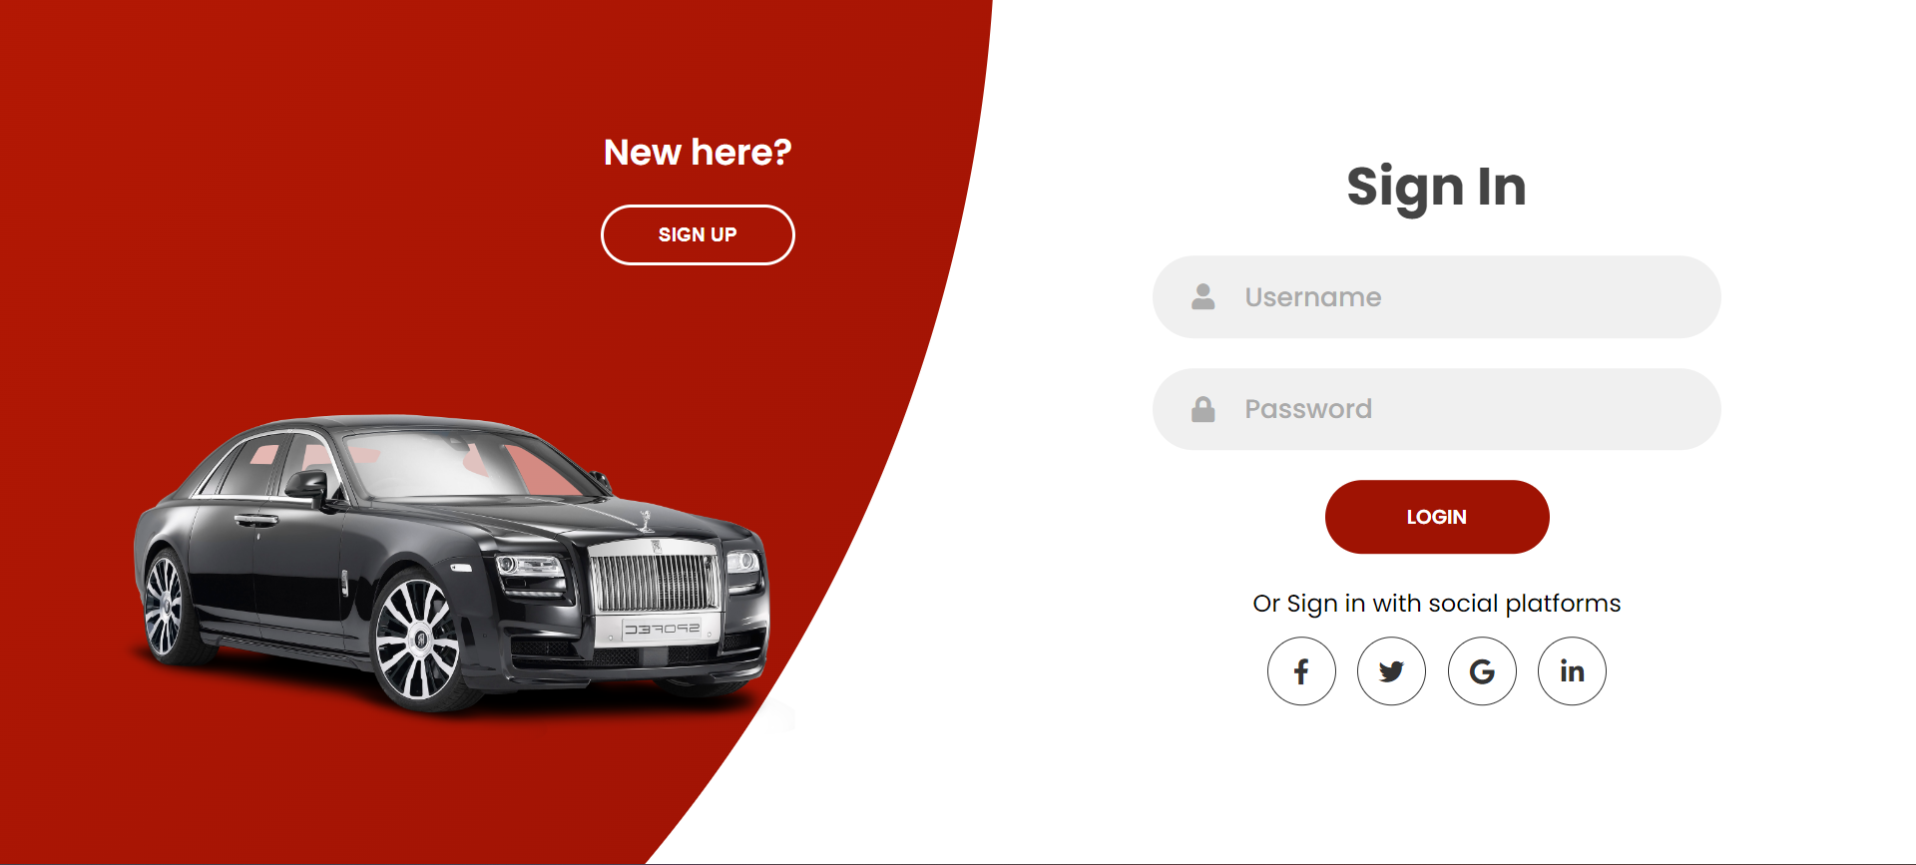
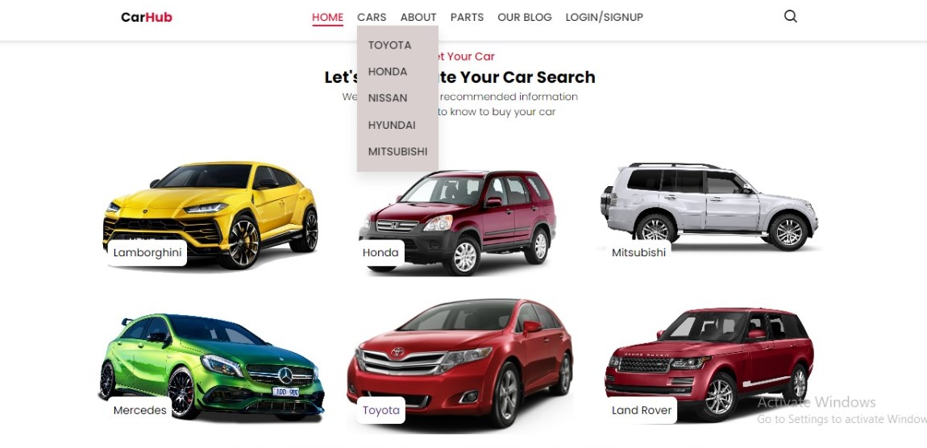
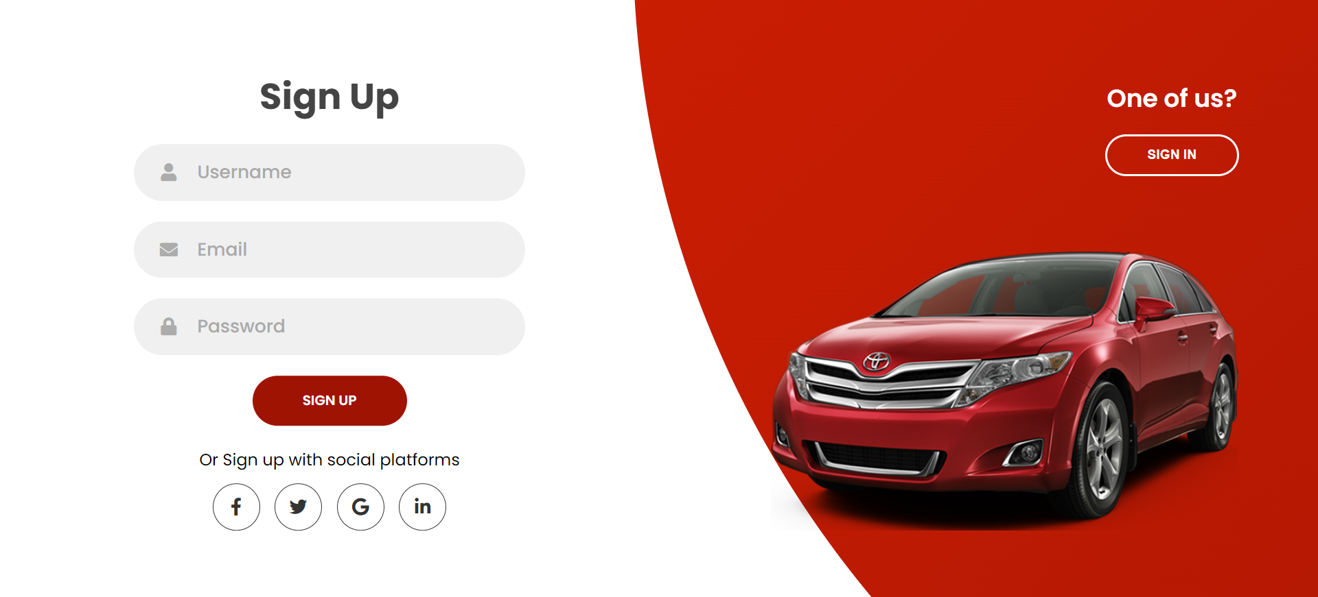
Project prototype

Slide 7
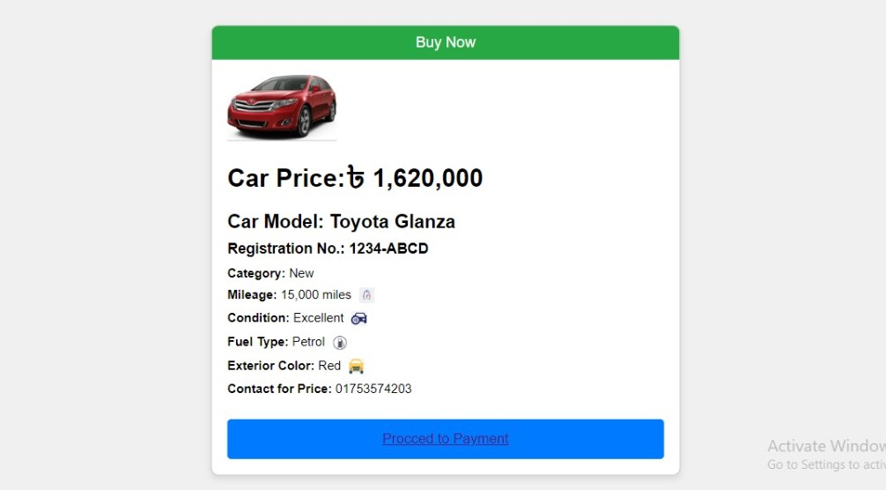
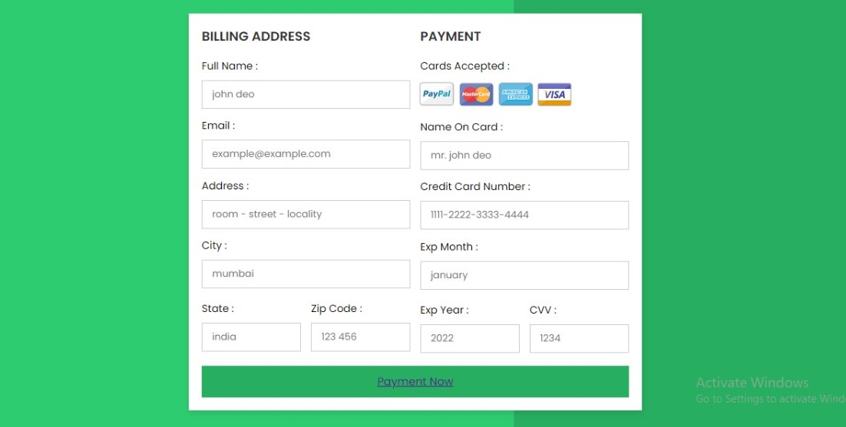
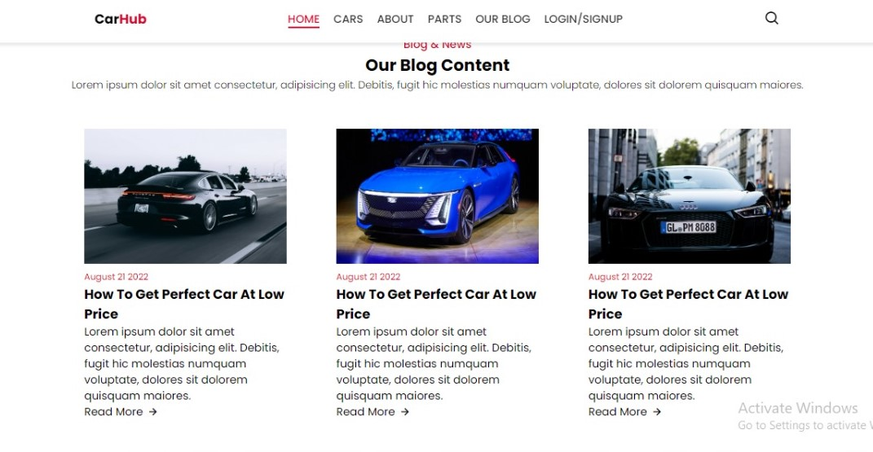
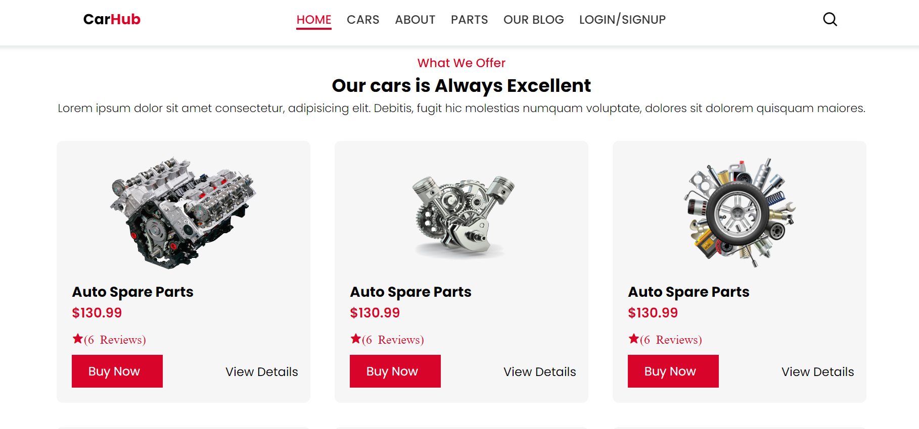
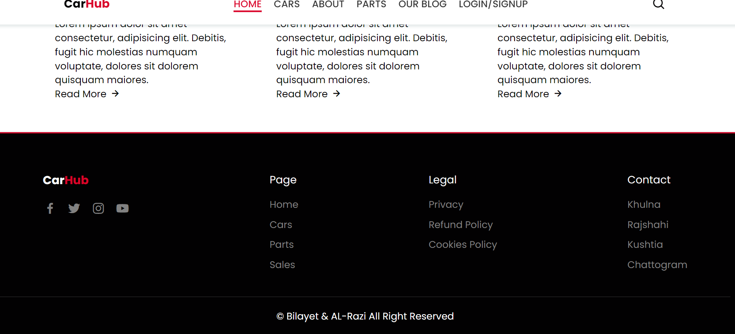

Slide 8
Future Work
Security
Login Api
Integrate Machine learning
Software Project III Presentation

Slide 9
Conclusion
This project aims to revolutionize the car selling and buying experience by offering a comprehensive online platform. By addressing existing gaps and incorporating advanced features, the platform will provide a reliable, user-friendly, and efficient service for all stakeholders involved.
Software Project III Presentation

Slide 10
Thank You
Software Project III Presentation

